Slide 1
Craig Mitchell Head of Waste Support Welsh Local Government Association

Slide 2
The Local Authority challenge, the support programme and implications for waste
Craig Mitchell
Head of Waste

Slide 3
Presentation
Scope and challenge
WG/WLGA support programme
Wider Resilience Issues
Community based activity

Slide 4
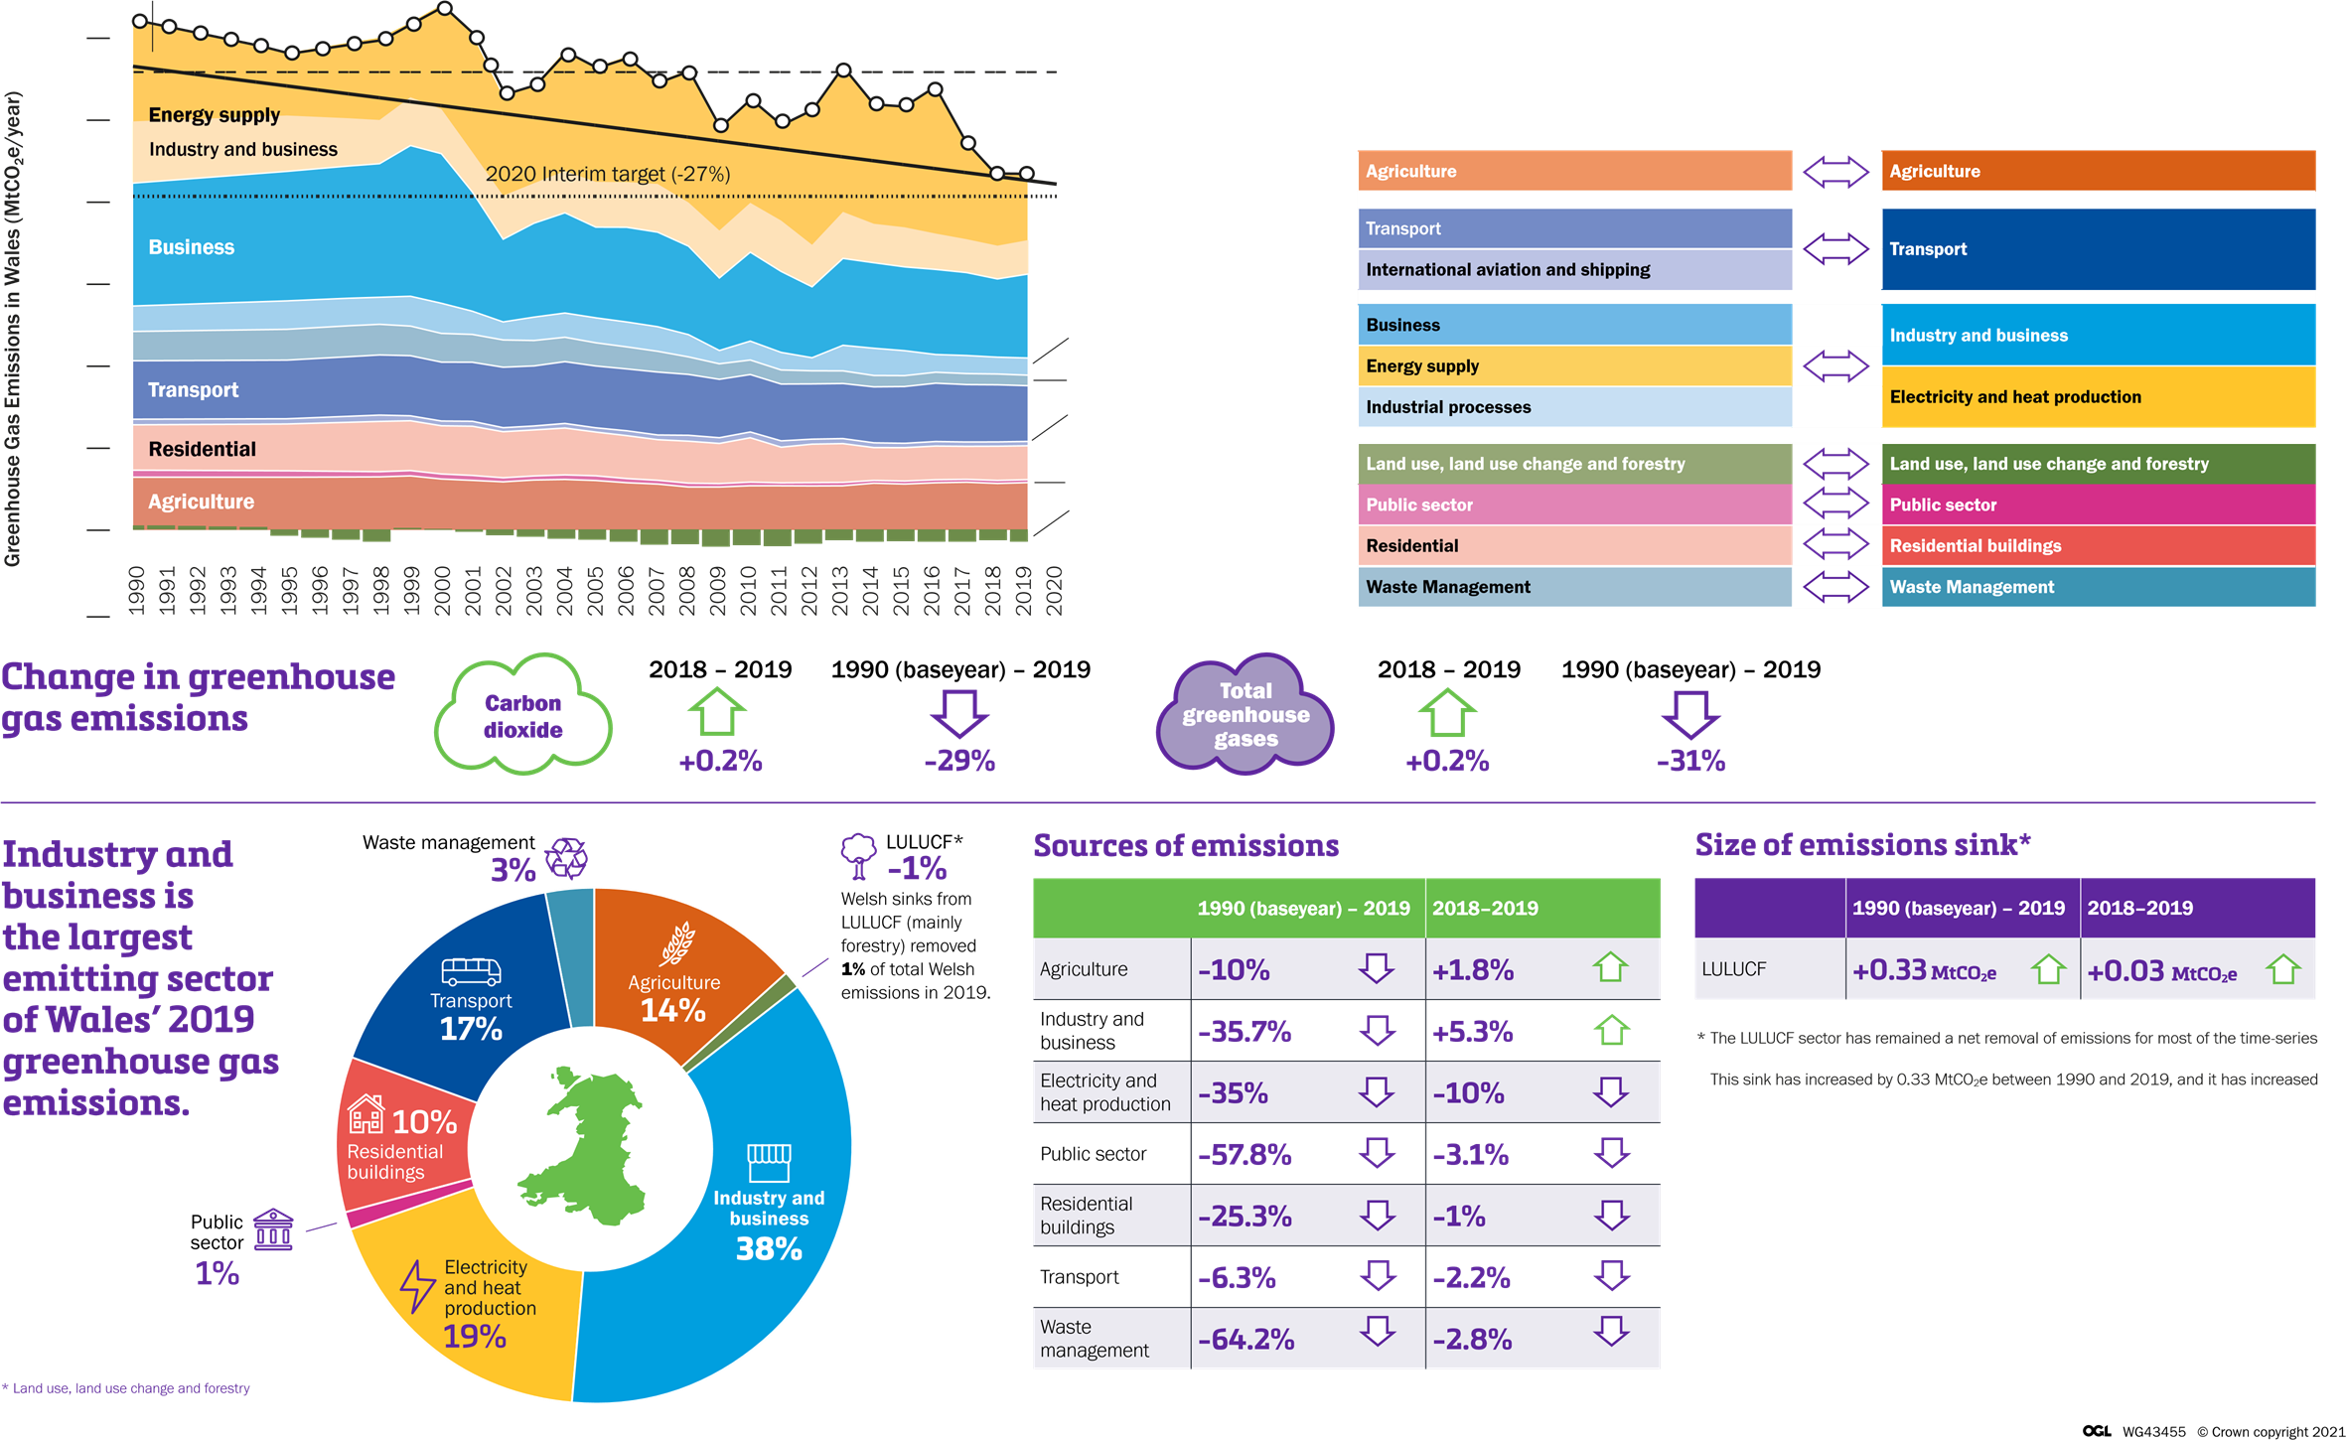
Emissions

Slide 5
The Challenge
“By 2030, choosing zero carbon will be routine, culturally embedded and self-regulating across the Welsh public sector”
The Transition & Recovery Support Programme is a Welsh Government funded programme that supports local authorities as they work towards net zero carbon by 2030.

Slide 6
Governance Issues
Partnership Council
Decarbonisation Strategy Panel
Council Decarbonisation strategies
Corporate Joint Committees – Economic Well Being, Transport and Planning
Ministerial Programme Board – Focus on Circular Economy
4 Regional MPB’s

Slide 7
Transition & Recovery Support Programme
Programme Overview

Slide 8
Developing TaRSP support
Deep dives with Climate Strategy Panel on;
Procurement
Buildings
Land Use
Transport & Mobility
Net Zero Wales Commitments
A detailed review of local authority decarbonisation action plans
(available on WLGA website)
Leadership & Behaviour Change
Low carbon infrastructure and transport
Procurement and reducing scope 3 emissions
Land Based Decarbonisation

Slide 9
Public Sector Decarbonisation Routemap
Mobility & Transport
Buildings
Procurement
Land Use

Slide 10
Net Zero Wales Carbon Budget 2 (2021-2025)
123 policies and proposals to reaching net zero.
Key commitments for local authorities based on the priorities in the public sector routemap.
A snapshot;
Buildings | Land Use | Transport & Mobility | Procurement
Develop and deliver a strategic plan for the local authority estate decarbonising existing (retained) buildings including retained council housing, moving to renewable energy sources for electricity and heating, and ensuring any new build is to net zero standards (in construction and operation). | Carbon sequestration seen by leaders as a valid core purpose for use of public land and opportunities actively pursued by local authorities on their own land, including habitat restoration, tree planting etc as appropriate. | Accelerate transformation towards a zero emission fleet. Building on local authority fleet reviews completed in 2021, develop business plans through 2022 setting out how local authorities will decarbonise their fleet, including: › Accelerate the roll-out of EV charging infrastructure. › All new cars and light goods vehicles being net zero/ultra-low emission by 2025. › Reduce the carbon footprint of buses, taxis and private hire vehicles to zero by 2030. | Set out carbon reduction specifications in all new or reviewed contracts to accelerate the decarbonisation agenda.

Slide 11
Service Resilience
Joint project with Ricardo and WRAP
Covid demonstrated vulnerabilities
How to understand and manage risk on a local, regional and national basis

Slide 12
IPCC Resilience Definition
The capacity of social, economic and environmental systems to cope with a hazardous event or trend or disturbance, responding or reorganising in ways that maintain their essential function, identity and structure, while also maintaining the capacity for adaptation, learning and transformation.”

Slide 13
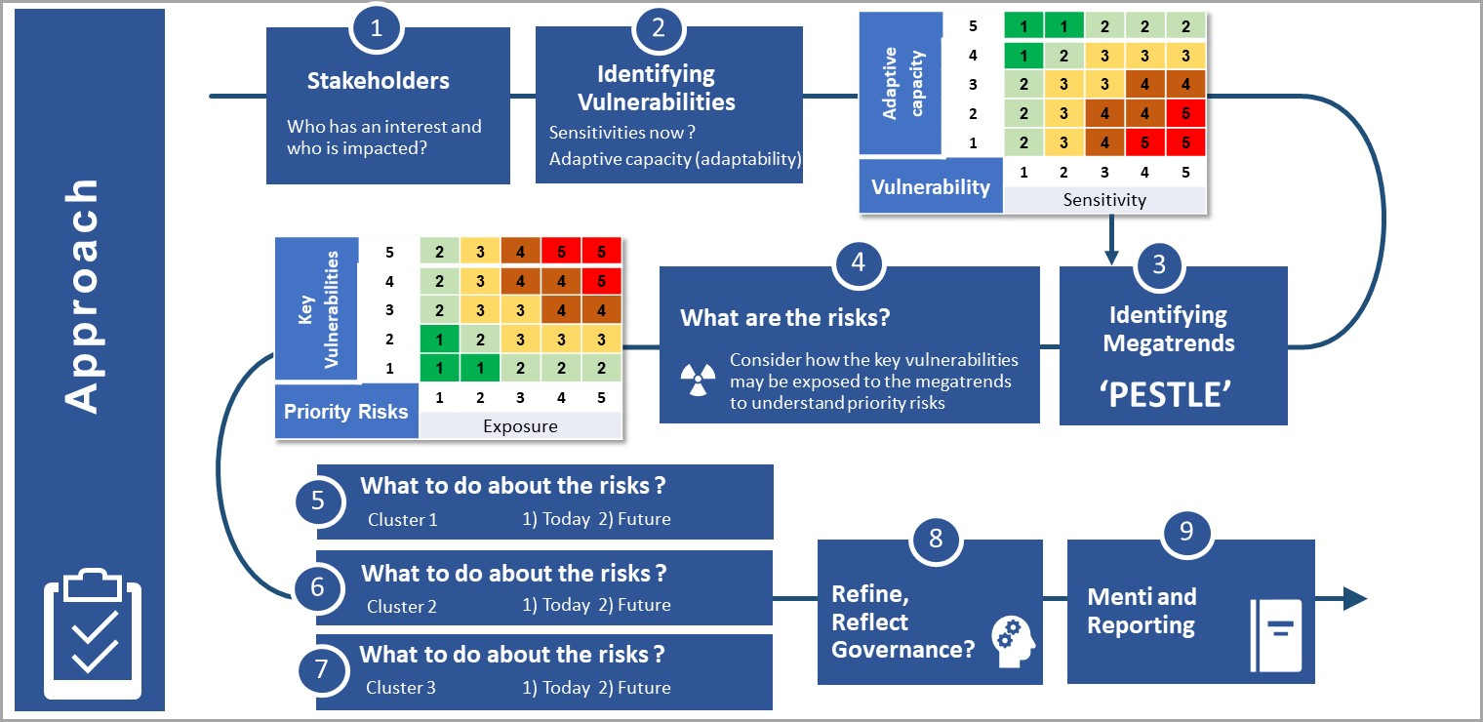
Approach

Slide 14
Circular Communities Project
• Welsh Government Strategy ‘Beyond Recycling’ launched
• Across Wales, we are now seeing a wide range of positive and successful examples of circular initiatives.
• Through focusing on how communities engage with the circular economy, we can identify ways to revitalise them and increase overall resilience.

Slide 15
Creating a community resilience model – putting the circular economy at the heart of building low carbon, resilient communities in Wales
Focused on measuring circularity at the local level, to support delivery of
Welsh Government strategies and circular economy ambitions.
• Possibility to link the project to wider work on towns and regeneration across
the Welsh Government, LDPs/SDP and place plans.
• Possibility to integrate into City Deal activity and CJC economic wellbeing duty

Slide 16
AIMS OF THE PROJECT
Develop an indicator set for measuring the circularity of towns and
communities in Wales that is adaptable to different settings/areas
Pilot the framework in 3 exemplar communities to reflect the regional
MPBs for waste
Develop a self assessment toolkit for each exemplar to measure progress against.
Encourage towns, villages and communities to develop in a greener,
more sustainable way, embracing the principles of circular economy

Slide 17
Final Points
Decarbonisation closely linked to Circular Economy
Resilience across the sector is critical
Behaviour Change - Community circularity key – changing role for town centres

