Slide 2
Recycling of flexible packaging Workshop
Jane Skelton
Commercial Manager, OPRL Ltd

Slide 3
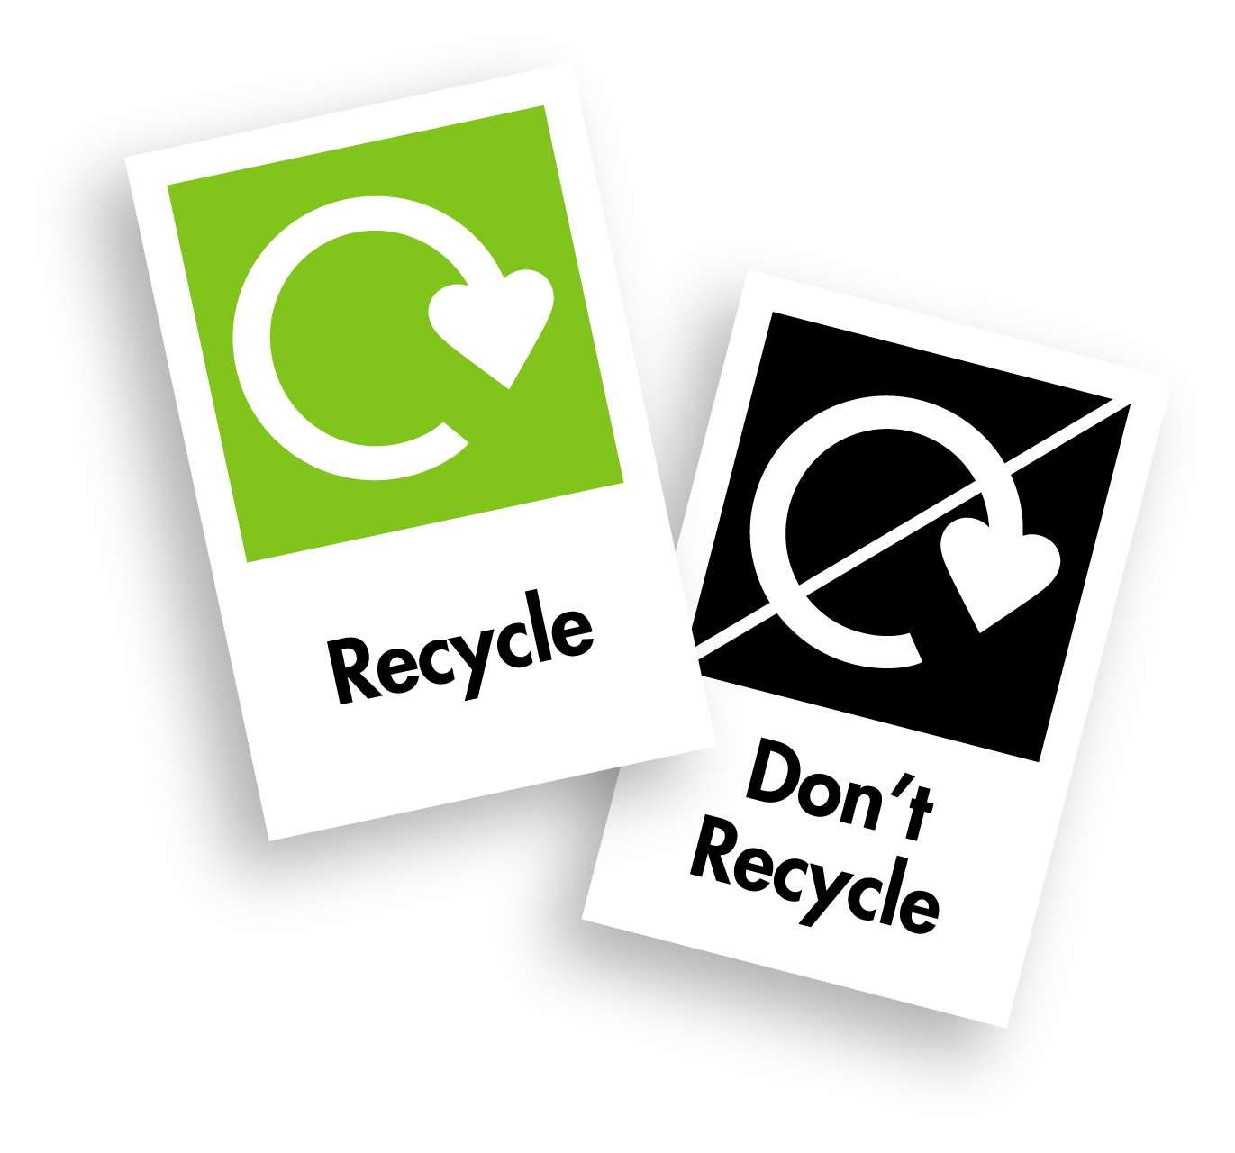
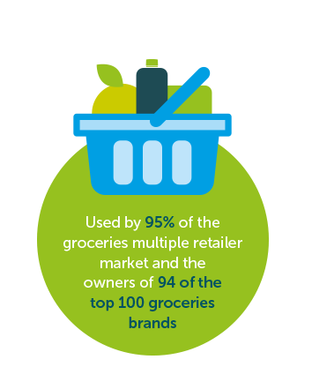
What We Do
Simple and Consistent Recycle and Refill Labels
Recycling Labels are Based on Collections, Recyclability and End-Markets
Widely Used and Recognised Labels
Tools and Membership Support When You Need It
Collaboration and Knowledge Share
Additional Products and Services
Notes:
Simple and Consistent Recycle and Refill Labels
The OPRL scheme was created to deliver a simple, consistent and UK-wide recycling and refill messages on retailer and brand packaging designed to help businesses help consumers recycle and reuse packaging better, more often.
Recycling Labels are Based on Collections, Recyclability and End-Markets
Our labelling scheme takes account of the whole recycling process from council and in-store collections to sorting at MRFs and the likelihood of reprocessing into recyclate and use in packaging or other products. We also have refill labels developed and consumer-tested to enable OPRL members to engage consumers in using refill systems appropriately.
Widely Used and Recognised Labels
OPRL labels are used by 95% of groceries retailers and 94 of the top 100 Groceries brands. They are also recognised and inspire confidence in 9 out of 10 consumers and referenced by the UN Environment Programme as international best practice.
Tools and Membership Support When you Need it
As a member, we provide you with the tools and support to either assess or choose the right label for your packaging. This is via a number of tools exclusively available to OPRL members and support from our Membership Services team. <Explain labelling tool and PREP>
Collaboration and Knowledge Share
The support we give our members is underpinned by the collaboration and knowledge share we do continually with Governments and organisations across the sector. We work closely with the UK Government and devolved governments on policies that impact our members, and organisations including to ensure we provide our members with the most up to date information and decisions which are made that impact their organisations in relation to packaging. We also work closely with our guarantors who come from across the packaging industry and other organisations such as WRAP, BRC and XXX
Additional Products and Services
In addition to our core labelling scheme, we offer additional products and services which provide support and guidance to our members. And they are evolving. We offer a service called Certified as Recyclable , exclusively available to our members which allows technical assessments to be made on packaging which is new to the market and has not been previously assessed. This is currently only for rigid plastics but we are looking to expand into fibre materials soon.

Slide 4
Who We Work With
Packer / Fillers
Design Agencies
Governments
Packaging Manufacturers
Our Purpose
To collaborate across the packaging cycle to drive circularity and transformation in packaging resource efficiency.
Re-processors
End Markets
Retailers and Brands
Waste Management Companies
Consumers
Local Authorities
Notes:
While a labelling scheme in title, we work across the packaging sector to ensure we use collaboration to keep our information and tools up to date and share our voice on issues which impact our members and the ambition of getting consumers to recycle better, more often.
Our organizational purpose is defined as … To collaborate across the packaging cycle to drive circularity and transformation in packaging resource efficiency.
We work with the Government and devolved nations, local authorities, Waste Management Companies, Retailers and Brands, Packaging Manufacturers,, Start-ups and Sole Traders and supply chain including packer/fillers and design agencies and the list goes on.

Slide 5
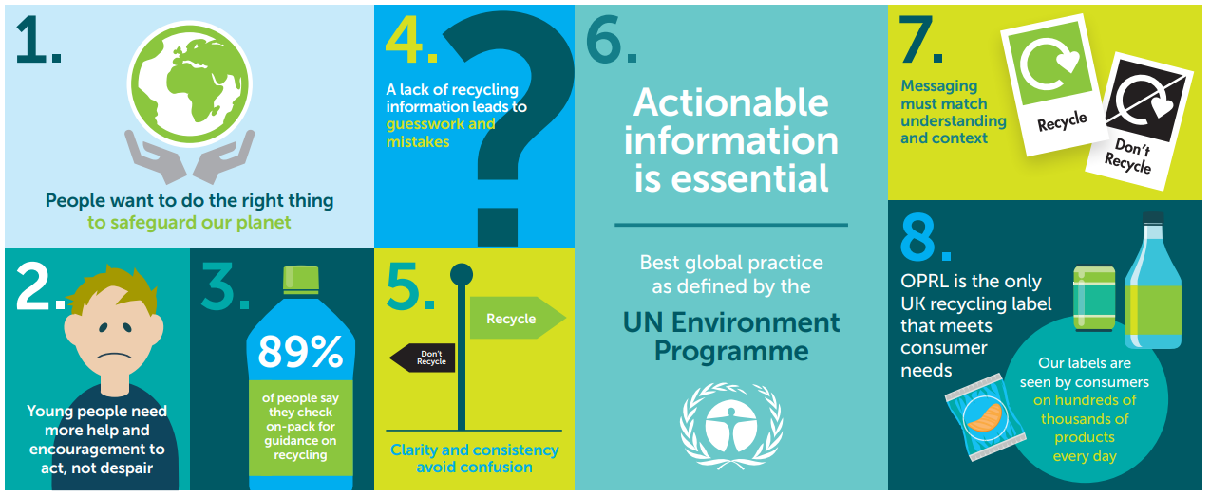
Backed by Consumer Insights
Key Insights from research over 5,000 consumers in February/March 2021:
Notes:
Understanding what information consumers respond to – and how they behave – is essential to get consumers recycling more often. Our consumer insights draw on five major pieces of consumer insight research, including a study with over 5,000 consumers in February/March 2021, undertaken for OPRL Ltd by Tangible Branding, a consumer research company.

Slide 6
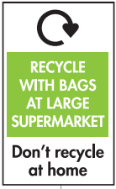
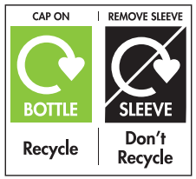
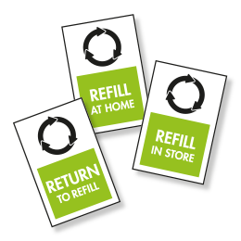
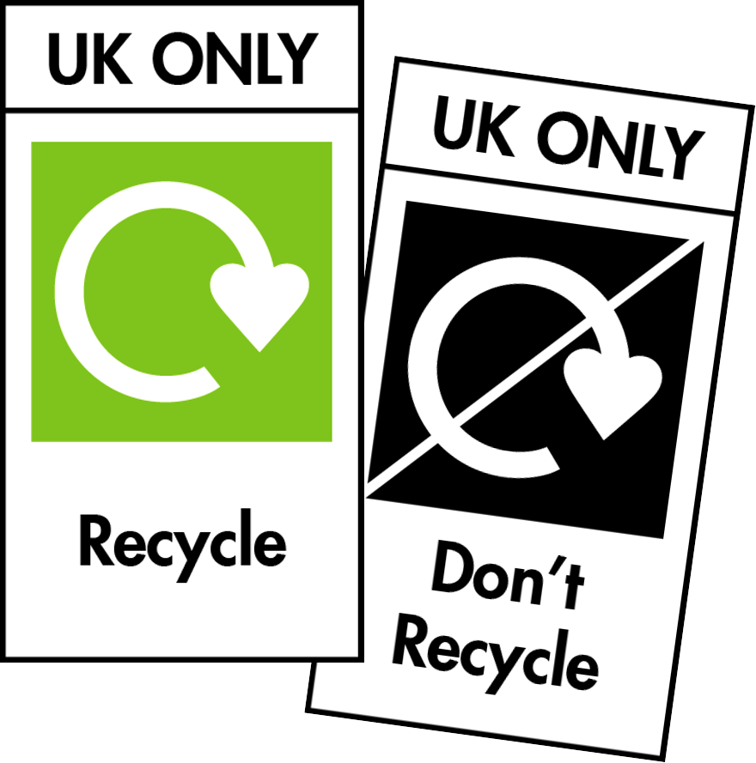
Label Variants
Recycle
Used when 1. More than 75% of UK councils collect for recycling 2. Industry guidance shows infrastructure sorts and processes for recycling 3. Material is sold on as recyclate
Don’t Recycle
Used when fewer than 50% of UK councils collect for recycling or more than 50% of councils collect but industry guidance shows infrastructure cannot sort or no viable markets exist for recyclate
Specialist*
Used for a small number of materials which may not always be collected through household recycling collections
Multi Component
Packaging may have a number of components that will need labelling separately.
Refill
Refill labels have been developed and consumer-tested to enable OPRL members to engage their customers in using refill systems appropriately
UK Only
To help where packaging is placed beyond the UK, this option allows you to include a UK only message as part of the label artwork.
* Note: there are multiple versions of our specialist labels

Slide 7
Flexible packaging facts and the challenge
Flexible plastic packaging represents a nearly a quarter of all UK consumer plastic packaging.
But only 6% is currently recycled.
Urgent action is required to address the complex challenges that underpin this.
It is an essential packaging format for certain product categories to keep them safe and for food, keep them fresh
We must act now or risk missing UK Plastics Pact targets.

Slide 8
UK Plastic Pact – where we should focus our efforts
Designing packaging that can be recycled and sorted.
In the short term, capitalising on the front of store collection points provided by many supermarkets.
In the long term, implementing collection at kerbside in all local authority areas.
Investing in sorting and reprocessing capacity and capabilities.
Ensuring recycled flexible plastic packaging has strong and stable end markets

Slide 9
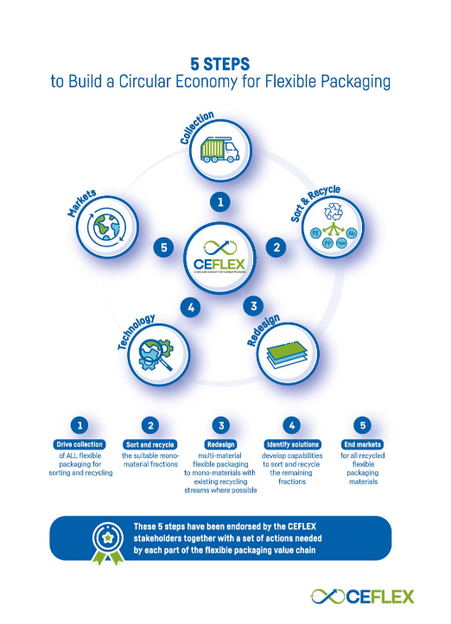
CEFLEX - The Circular Economy for Flexible Packaging
The Circular Economy for Flexible Packaging (CEFLEX) initiative is a collaboration of European companies, associations and organisations representing the entire value chain of flexible packaging.
Together, we work to make all flexible packaging in Europe circular by 2025.

Slide 10
The workshop
How can move towards kerbside collection for all?
Can investment be made for sorting and reprocessing capacity and capabilities?
What are the recycled flexible plastic packaging strong and stable end markets?

